Slide 1
CSE326 Internet Programming Laboratory Lecture #3
Dr. Navneet Kaur

Slide 2
Outline
Images
Hyperlinks
Image links
Formatting text in HTML
Section tag
Lists
Unordered list
Ordered list
Description list

Slide 3
Images
The <img> HTML element embeds an image into the document.
src
alt
height
width
<img src="image_name.image_extension" alt=" ">

Slide 4
Images
<figure>
<img src="image_name.image_extension" alt=" ">
<figcaption>Fig. 1 - Image caption</figcaption>
</figure>

Slide 5
Hyperlinks
A hyperlink is a text or an icon that you can click on to get to another website.
A basic link is created by wrapping the text or other content inside an <a> element and using the href attribute, also known as a Hypertext Reference, or target, that contains the web address.
<a href="https://www.google.com">Click here</a>

Slide 6
Image links
If you have an image you want to make into a link, use the <a> element to wrap the image file referenced with the <img> element.
<a href="#">
<img src=" " alt=" " >
</a>

Slide 7
Formatting text in HTML
HTML Formatting involves structuring text to enhance its visual appearance and overall aesthetic appeal.
<b> → used to bold the text written between it.
<strong> → used to show if the text is important.
<i> → used to make the text italic.
<em> → used to make the text italic.
<sup> → used to indicate that the enclosed text should be displayed as superscript
<sub> → used to indicate that the enclosed text should be displayed as subscript

Slide 8
Formatting text in HTML
<big> → used to increase the size of the enclosed text.
<small> → used to reduce the size of the enclosed text.

Slide 9
Section tag
This is also called as the generic section element.
The HTML tag defines a section in the document that generally includes a group of related content.
<section>
</section>

Slide 10
Lists
HTML lists are used to display related information in an easy-to-read and concise way.
Unordered List <ul>
Ordered List <ol>
Description List <dl>

Slide 11
Unordered list
The unordered list is used to represent data in a list for which the order of items does not matter.
<ul type=‘ ’>
<li>Apple</li>
<li>Samsung</li>
<li>Microsoft</li>
</ul>
Portable and compact design
Built-in keyboard and touchpad
High-resolution display (LED, LCD, or OLED)
Frozen vegetables
Coffee
Tea bags
Peanut butter
Jam or jelly
square
Basmati rice
Mixed vegetables (such as carrots, peas, beans, potatoes, etc.)
Onions
Tomatoes
disc
circle

Slide 12
Ordered list
The ordered list is used to represent data in a list for which the order of items has significance.
An ordered list can be numerical or alphabetical.
<ol type=‘ ’>
<li>Apple</li>
<li>Samsung</li>
<li>Microsoft</li>
</ol>
A
a
Frozen vegetables
Coffee
Tea bags
Peanut butter
Jam or jelly
Frozen vegetables
Coffee
Tea bags
Peanut butter
Jam or jelly
1
I
Frozen vegetables
Coffee
Tea bags
Peanut butter
Jam or jelly
Frozen vegetables
Coffee
Tea bags
Peanut butter
Jam or jelly
Frozen vegetables
Coffee
Tea bags
Peanut butter
Jam or jelly
i

Slide 13
Description list
The HTML description list is used to represent data in the name-value form.
We use the <dl> tag to create a definition list and each item of the description list has two elements:
term/title - represented by the <dt> tag
description of the term - represented by the <dd> tag

Slide 14
References
https://www.w3schools.com/tags/tag_img.asp
https://www.w3schools.com/tags/tag_a.asp
https://www.w3schools.com/tags/tag_section.asp
https://www.w3schools.com/html/html_formatting.asp
https://www.w3schools.com/html/html_lists.asp

Slide 15
Program link
https://www.onlinegdb.com/wZIoh6flk

Slide 16
Week 3 assignment
Go to → https://www.freecodecamp.org/learn/2022/responsive-web-design/
Complete steps 6 to 34 of “Learn HTML by building a Cat Photo App”

Slide 17
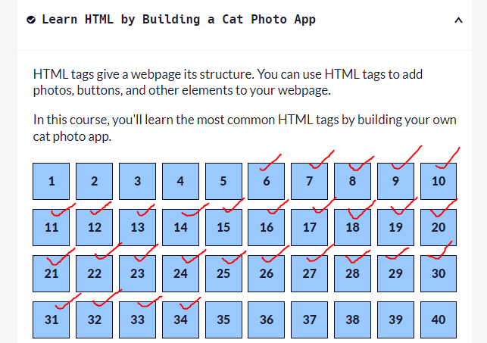
Week 3 assignment

Slide 18
Thank you

